Slide 1
9-ANEKA—INTEGRATION OF PRIVATE AND PUBLIC CLOUDS
Cloud Computing
Principles and Paradigms

Slide 2
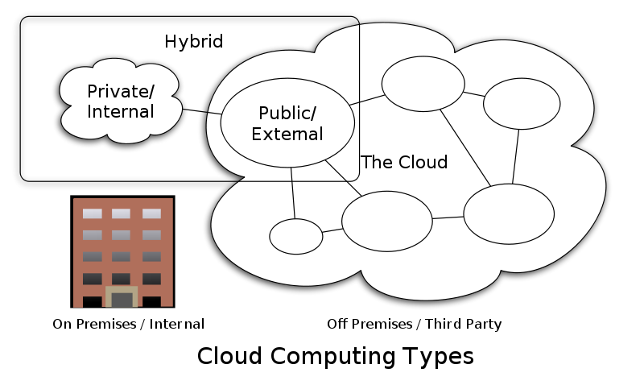
Introduction
How to form private and public cloud?
Private cloud
Advantages
Information Protection
Ensuring SLA
Standards
Disadvantages
Scale out
Solution
Hybrid clouds
PaaS solutions
Manjrasoft Aneka
Notes:
A growing interest in moving software applications, services, and even infrastructure resources from in-house premises to external providers has been
witnessed recently. The possibility of instantly reacting to the demand of customers without long-term planning is one of the most appealing features of cloud computing.
enterprises already have their own IT infrastructures. In spite of this, the distinctive feature of cloud computing still remains appealing, and the possibility of replicating in-house (on their own IT infrastructure) the resource and service provisioning model proposed by cloud computing led to the development of the “Private Cloud” concept.
Advantages
Security in-house is easier to maintain and to rely on. Public clouds have assurance in security but not warranty.
public clouds vendors provide some QoS features, not all of them are available as needed
Standards (putting procedures when executing application) could be not possible in the case of virtual public infrastructure
In spite of these advantages, private clouds cannot easily scale out in the case of peak demand, and the integration with public clouds could be a solution to the increased load. Hence, hybrid clouds, which are the result of a private cloud growing and provisioning resources from a public cloud, are likely to be best option for the future in many cases.
Platform as a Service (PaaS) solutions offer the right tools to implement and deploy hybrid clouds.
Aneka [3] is a programming and management platform for building and deploying cloud computing applications. The core value of Aneka is its service-oriented architecture that creates an extensible system able to address different application scenarios and deployments such as public, private, and heterogeneous clouds.

Slide 3
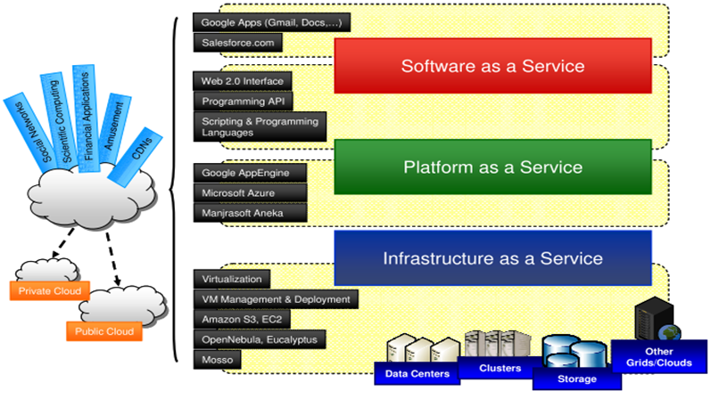
Technologies and Tools
Deploying private cloud
VM technologies
VM managers
IaaS
Amazon
EC2,S3
GoGrid
3Tera AppLogic
PaaS
Microsoft Azure
Google AppEngine
Other Tools (commercial and research)
DataSynapse, Elastra, Zimory Pools, App-Logic
Aneka, OpenNebula, Nimbus
Notes:
For what concerns the Platform-as-a-Service solutions, we can notice DataSynapse, Elastra, Zimory Pools, and the already mentioned App-Logic.
Aneka, as OpenNebula and Nimbus, is characterized by a modular architecture that allows a high level of customization and integration with existing technologies, especially for what concerns resource provisioning.

Slide 4
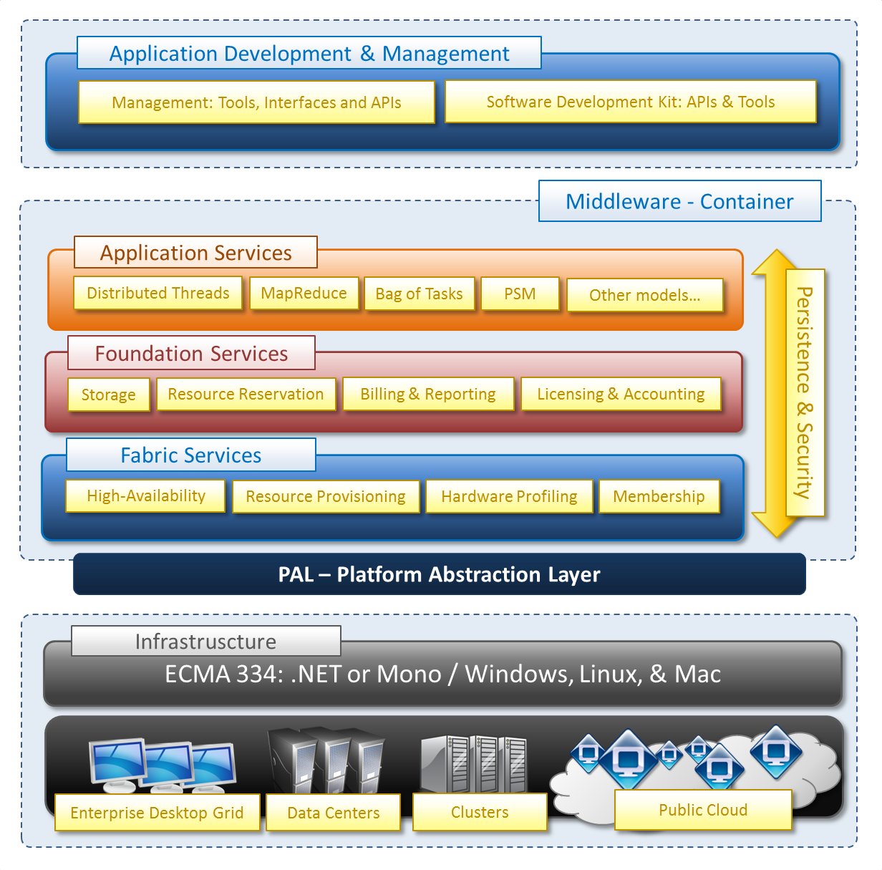
ANEKA - Architecture
Notes:
Aneka [3] is a software platform and a framework for developing distributed applications on the cloud. It harnesses the computing resources of a heterogeneous network of workstations and servers or data centers on demand.
Aneka is essentially an implementation of the PaaS model, and it provides a runtime environment for executing applications by leveraging the underlying infrastructure of the cloud.
The Aneka container—the basic building block of Aneka clouds—can be easily deployed on different hardware: a desktop PC, a workstation, a server, a cluster, and even a virtual machine. This flexibility allows the quick setup of heterogeneous execution environments on top of which distributed applications can run transparently.
Aneka is for public, private and hybrid cloud.
Developers can express distributed applications by using the API contained in the Software Development Kit (SDK) or by porting existing legacy applications
to the cloud.
There are three classes of services that characterize the container:
- Execution Services. They are responsible for scheduling and executing applications.
- Foundation Services. These are the core management services of the Aneka container. They are in charge of metering applications, allocating resources for execution, managing the collection of available nodes, and keeping the services registry updated. Membership Catalogue: Acts as global directory maintaining the list of available services and their location.
- Fabric Services: They constitute the lowest level of the services stack of Aneka and provide access to the resources managed by the cloud. An important service in this layer is the Resource Provisioning Service, which enables horizontal scaling in the cloud.
platform abstraction layer that interfaces it with the underlying host, whether this is a physical or a virtualized resource. This makes the container portable over different runtime environments. It can install on the following OS: Windows, Linux, Mac OS X

Slide 5
features of hybrid clouds
Support for Heterogeneity
integrate additional cloud service providers (IaaS) without major changes to the entire system
Support for Dynamic and Open Systems
plugging new components and rapidly integrating new features
Support for Basic VM Operation Management
software frameworks that support hypervisor-based execution should implement a minimum set of operations
Support for Flexible Scheduling Policies
Public and private resources can be differently utilized, and the workload should be dynamically partitioned
Support for Workload Monitoring
To lease a subset of resources and dismiss resources if they are no longer necessary
Notes:
most relevant features (of Aneka) for successfully supporting the deployment and the management of hybrid clouds:
Support for Heterogeneity
Hybrid clouds are produced by heterogeneous resources such as clusters, public or private virtual infrastructures, and workstations. In particular, for what concerns a virtual machine manager, it must be possible to integrate additional cloud service providers (mostly IaaS providers) without major changes to the entire system design and codebase. Hence, the specific code related to a particular cloud resource
provider should be kept isolated behind interfaces and within pluggable components.
Support for Dynamic and Open Systems
Hybrid clouds change their composition and topology over time. They form as a result of dynamic conditions such as peak demands or specific Service Level Agreements attached to the applications currently in execution. An open and extensible architecture that allows easily plugging new components and rapidly integrating new features is of a great value in this case.
Support for Basic VM Operation Management
Hybrid clouds integrate virtual infrastructures with existing physical systems. Virtual infrastructures are produced by virtual instances. Hence, software frameworks that support hypervisor-based execution should implement a minimum set of operations.
Support for Flexible Scheduling Policies
The heterogeneity of resources that constitute a hybrid infrastructure naturally demands for flexible scheduling policies. Public and private resources can be differently utilized, and the workload should be dynamically partitioned into different streams according to their security and quality of service (QoS) requirements. There is then the need of being able to transparently change scheduling policies over time with a minimum impact on the existing infrastructure and almost now downtimes. Configurable scheduling policies are then an important feature.
Support for Workload Monitoring.
Support for Workload Monitoring:
Workload monitoring becomes even more important in the case of hybrid clouds where a subset of resources is leased and resources can be dismissed if they are no longer necessary.

Slide 6
Research in Hybrid Clouds
Pricing Models
Security Standardization
Management and Scheduling Policies for heterogeneous environment
Security in hybrid cloud
Data retention
Possibility of massive outage
Provider trust
Jurisdiction (confidentiality of data)
Standardization
Notes:
Currently, the security measures and tools adopted for traditional distributed systems are used.
P270-P271

Slide 7
end
ANEKA - Integration Of Private And Public Clouds

